Slide 1
Geographic Information Systems (GIS)
Matt Taraldsen
Environmental Solutions Engineer, Esri
mtaraldsen@esri.com
AMS Student Conference 2018
Notes:
Esri Corporate Template-Dark v3.4
16:9 version – January 29, 2017
For more templates, sample files, and icons, see https://compass.esri.com/resources/presentations/Pages/Main.aspx
To add footer text in Windows
On the Home tab, under Insert, click Text, and then click Header and Footer.
Click the Slide tab, select the Footer check box, and then type the footer text that you want.
Click either Apply or Apply to All.
To add footer text on a Mac
On the View menu, select Header and Footer.
Select the Footer check box and then type the footer text that you want.
Click either Apply or Apply to All.
If footers don't appear on the slides
If footers don't appear on title slides, in the Header and Footer dialog box make sure the Don't show on title slide check box is not selected.
If the footers are missing from other slides, the placeholders for these items might have been removed from specific slide layouts or the slide master.

Slide 2
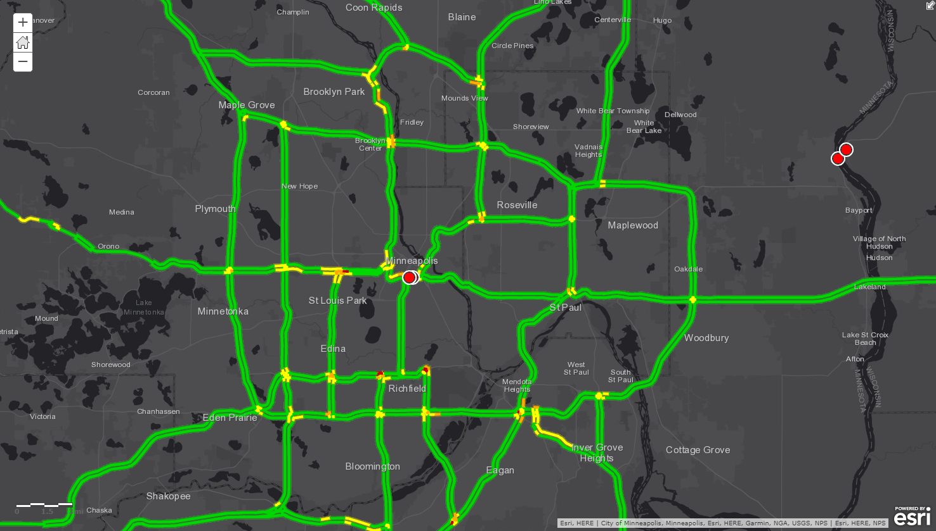
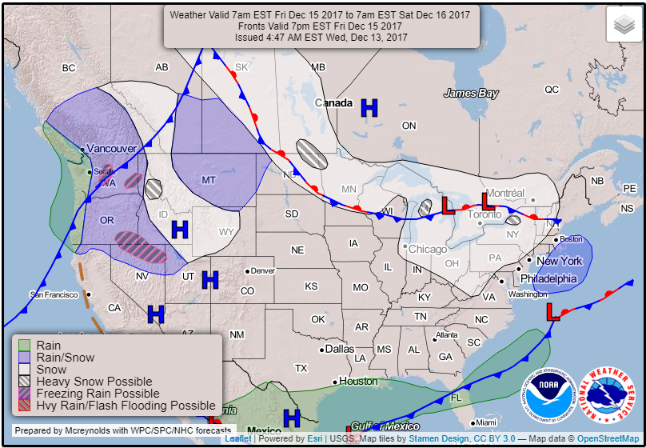

Slide 3
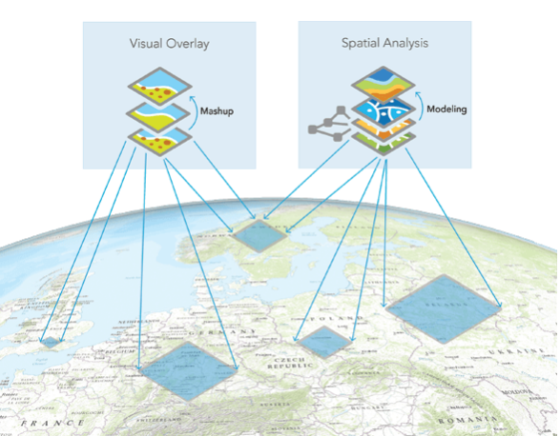
What is GIS?
A geographic information system (GIS) is a computer-based tool designed to capture, manage, analyze, and display all forms of geographically referenced information.

Slide 4
Geography Provides A Great Common Language
Nearly every dataset has a geographic component…
Geography makes an excellent common language and has applications in:
Research/Academia
Emergency Management
Broadcast Media
Local/State/Federal Agencies
Defense
Utilities
Aviation

Slide 5
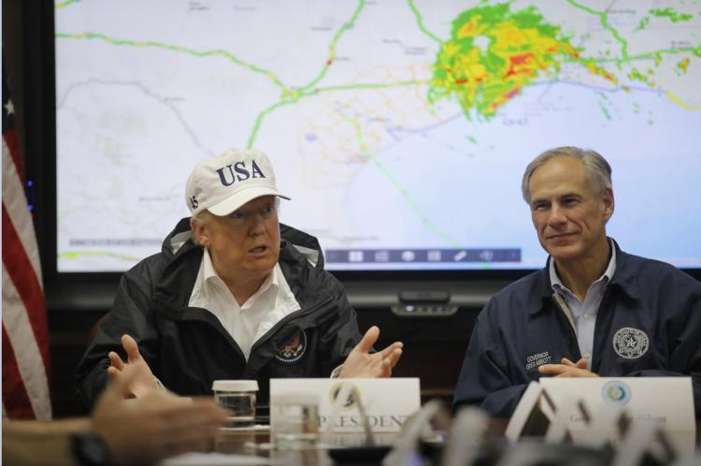
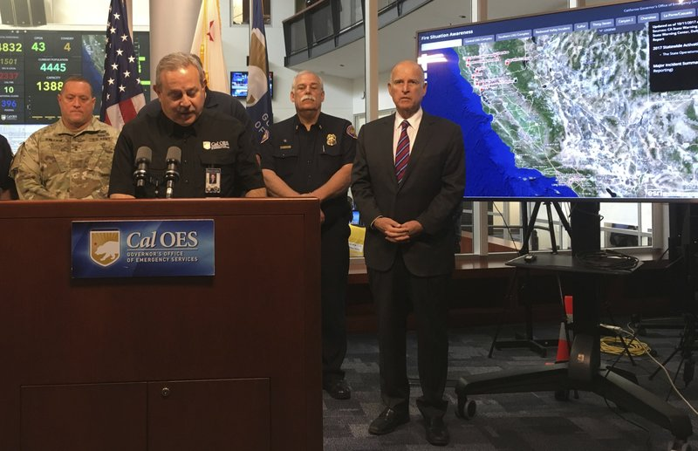
If You Don’t Believe Me….
Courtesy New York Daily News
Courtesy Associated Press

Slide 6
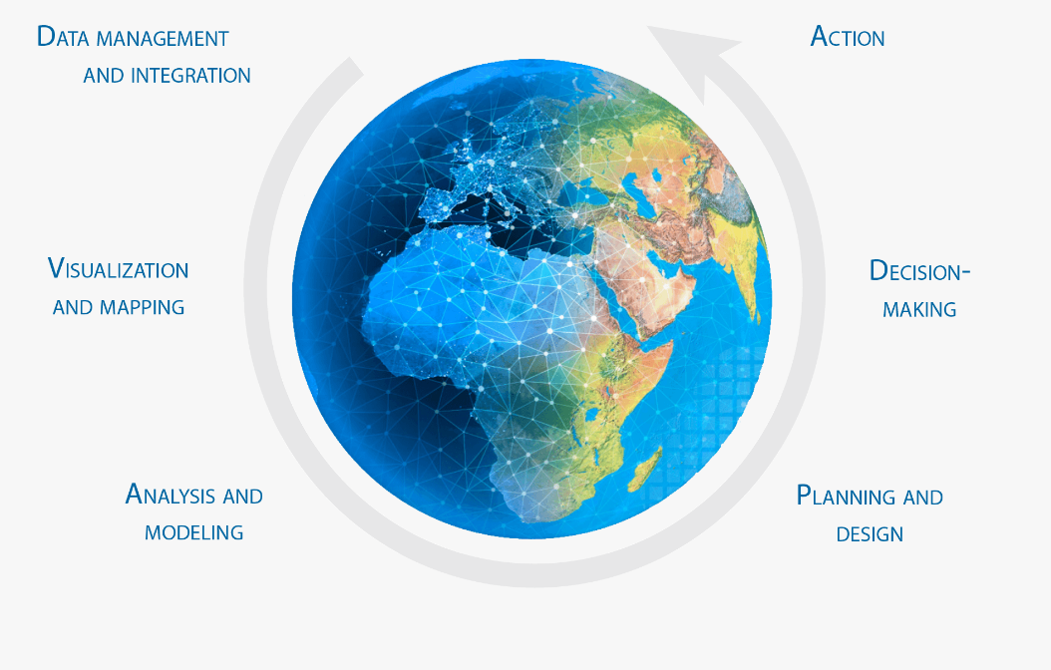
How is GIS Used?

Slide 7
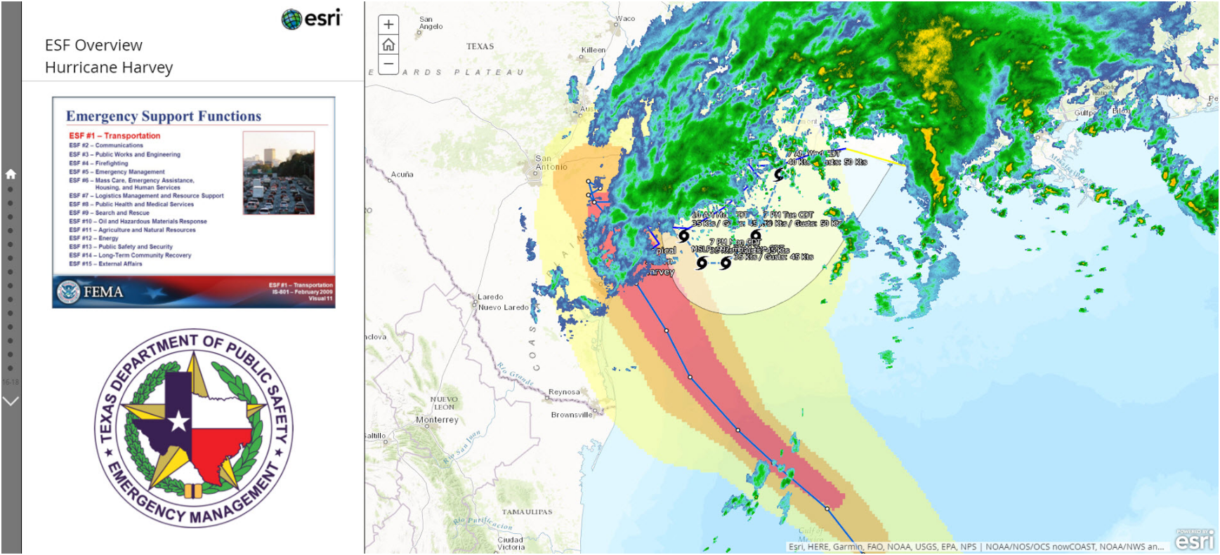
GIS Examples with Meteorology – Where Things Are

Slide 8
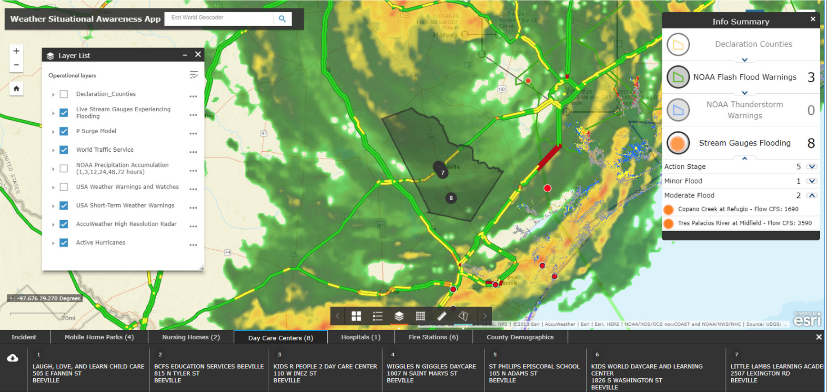
Meteorology Example – How Places Are Related

Slide 9
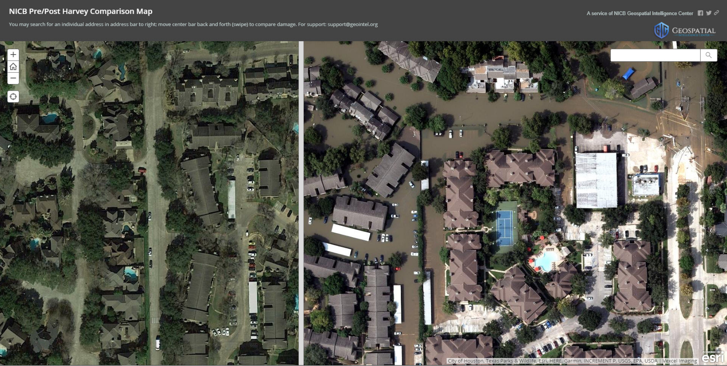
GIS Examples with Meteorology – Detecting Changes

Slide 10
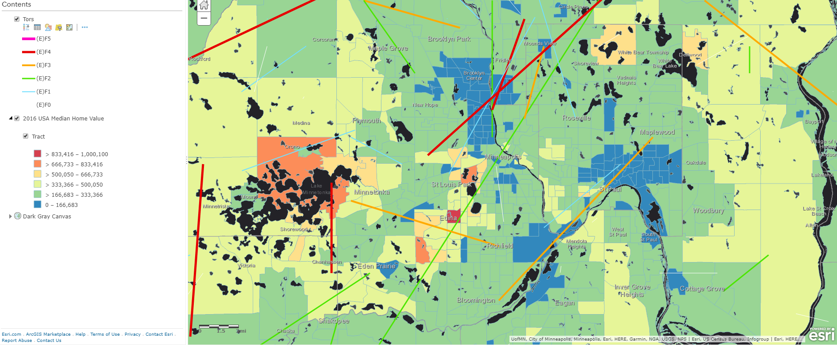
GIS Examples with Meteorology – Modeling Relationships

Slide 11
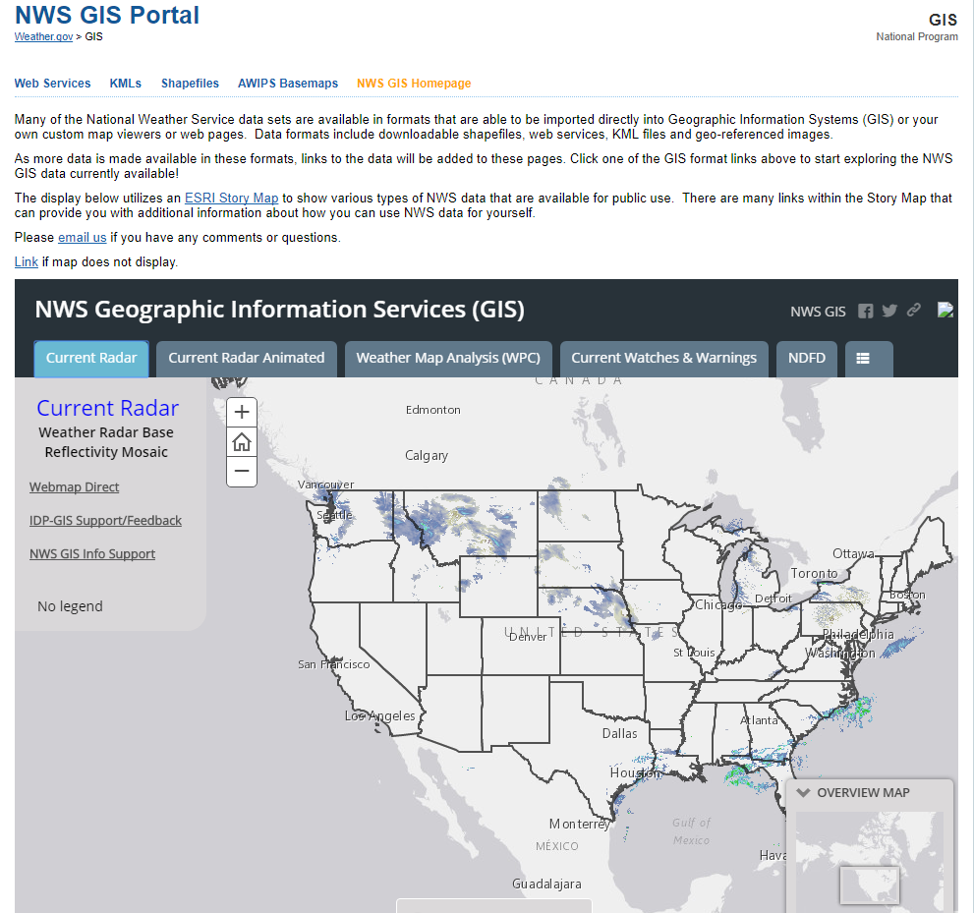
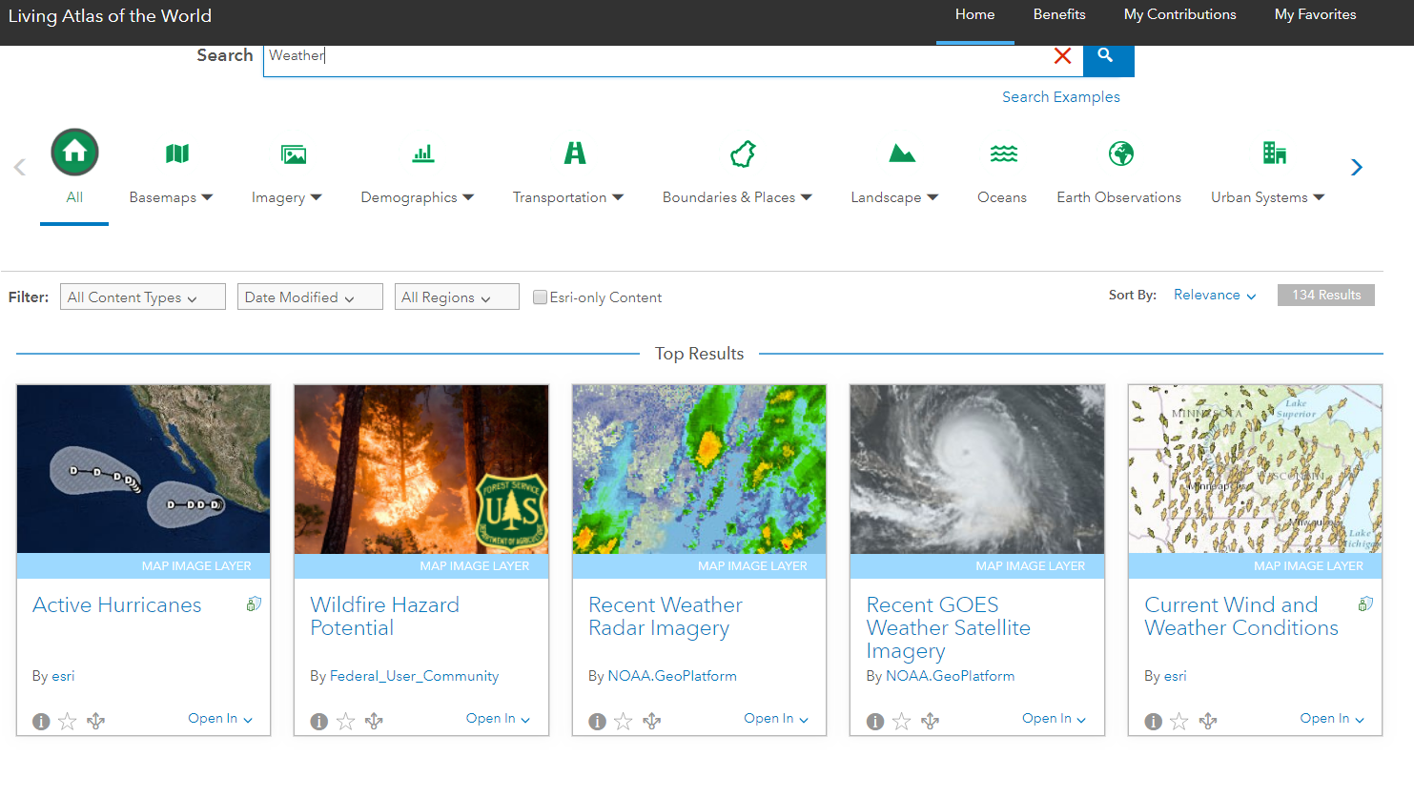
Finding GIS Data
Numerous Data Online For Free
See Supplemental Content

Slide 12
Skills in GIS That Can Help in Meteorology
Programming Skills
Database Management
Data Quality Control
Statistics/Analysis Skills
Utilizing Interdisciplinary Datasets
Presentation/Visualization Skills

Slide 13
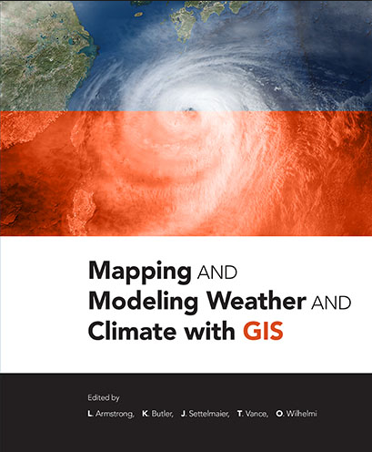
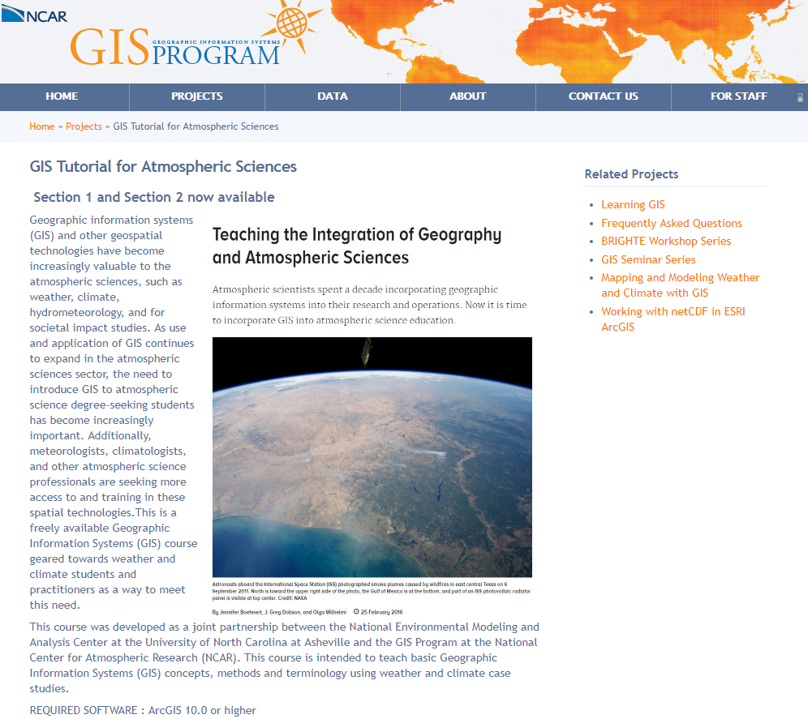
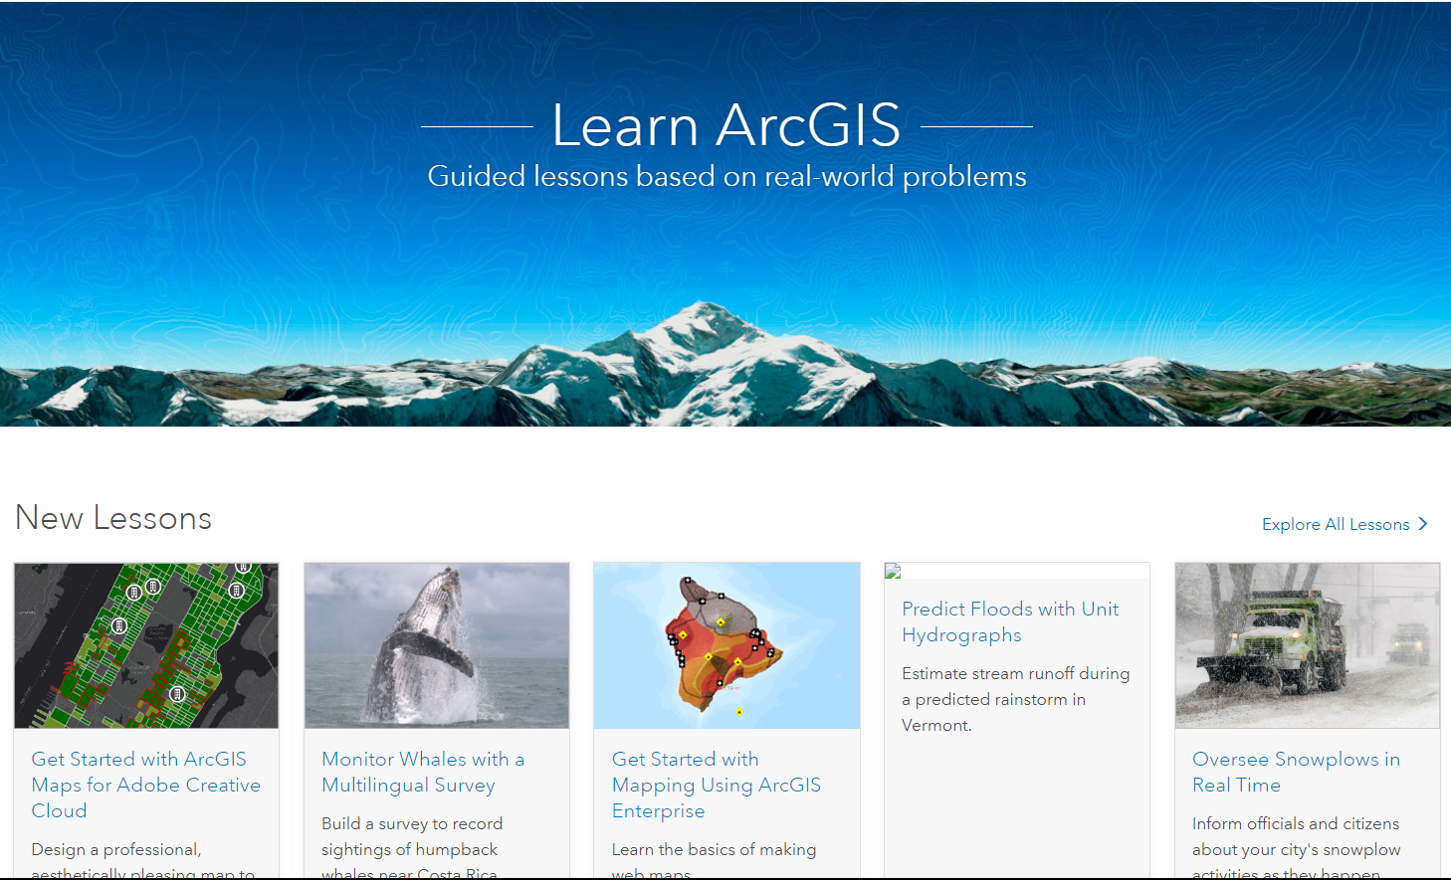
How Do I learn More?

Slide 14
mtaraldsen@esri.com

